Slide 1
Mapping Data
Created By: Jeffrey A. Shaffer Vice President, Unifund Adjunct Faculty, University of Cincinnati (513) 615-0001 | JeffreyShaffer@gmail.com @HighVizAbility
Notes:
Title Slide

Slide 2
Mapping Data

Slide 3


Slide 4
Geospatial:
If a picture is worth a thousand words,
then a map is worth a thousand cells.
Location can relate disparate data
Easy to see problem areas
By State, County, Zip, Block
Even down to individual Address

Slide 5
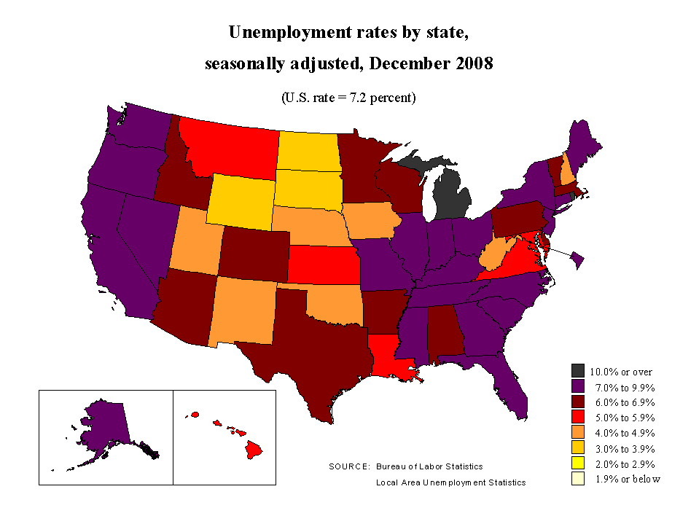
Notes:
Let’s start with this map by the Bureau of Labor Statistics. What they are attempting to show is the unemployment rate by State in December 2008, which was during the financial crisis. What’s the issue with the color here?
[let the class discuss color]
The problem is that they are using different color hues to represent higher unemployment. They are using yellow, orange, red, purple and black. Readers could certainly be confused trying to think of purple as worse than red and dark red.

Slide 6
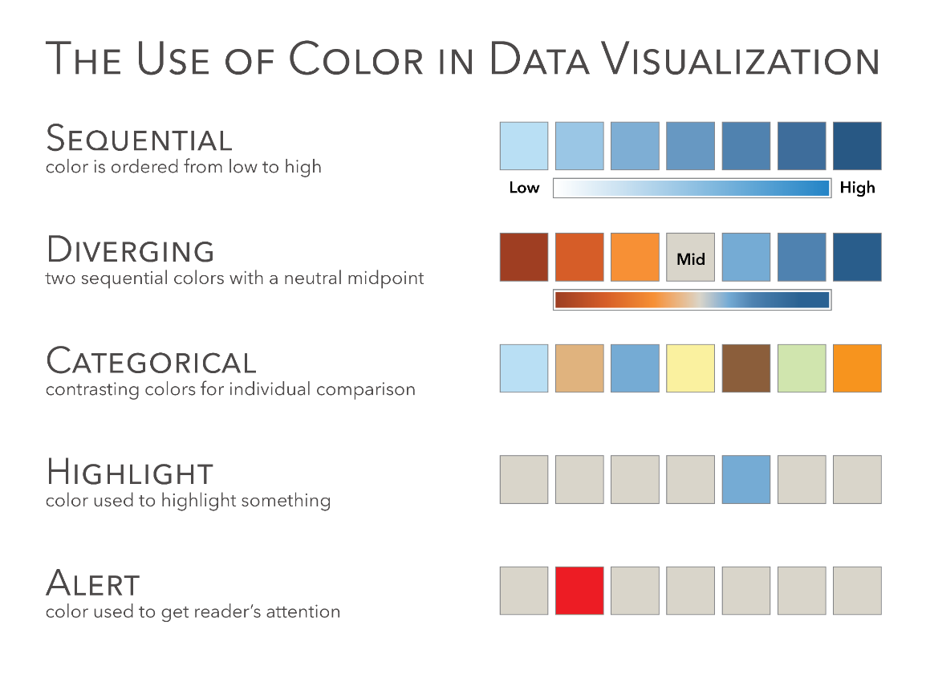
Source: The Big Book of Dashboards (page 15)
Notes:
Let’s pull up the Use of Color in Data Visualization again. What method should they have used here?
[let the class answer]

Slide 7
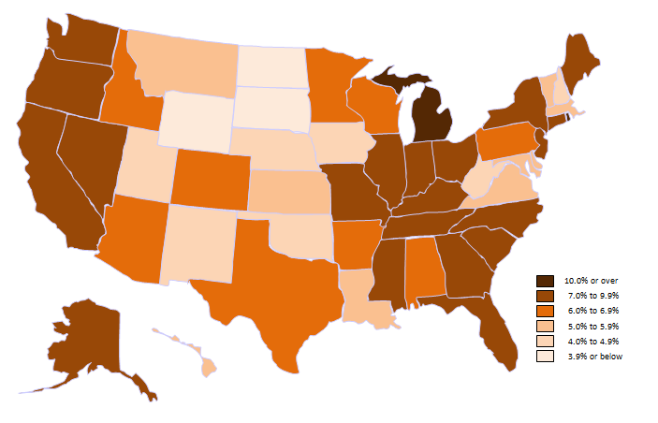
Notes:
A sequential color going from light to dark would have been better and much easier to read.

Slide 8
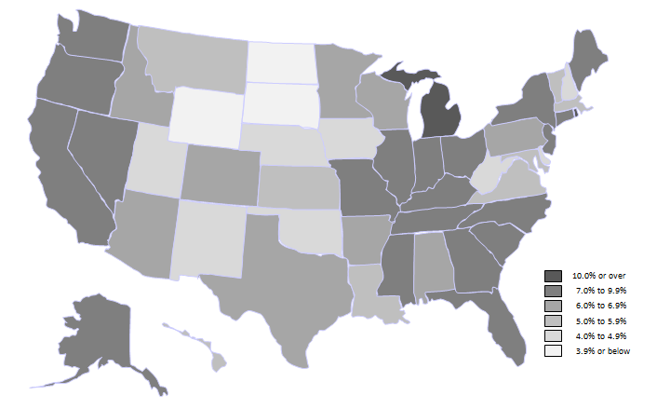
Notes:
They didn’t even need to use color, they could have just used a gray scale.

Slide 9
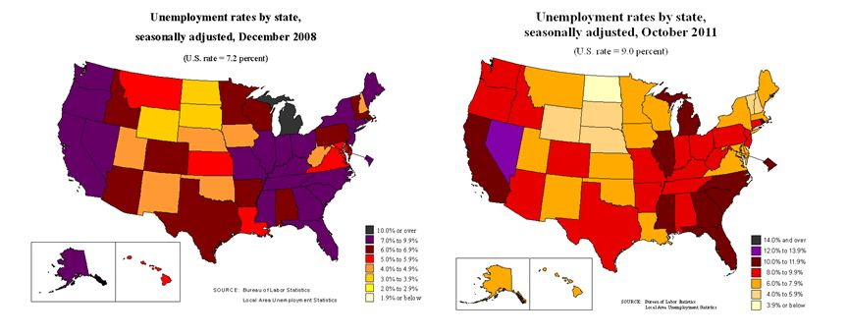
Notes:
To complicate the problem further, here are the maps for December 2008 and October 2011. What’s the problem now?
[let the class figure it out – it’s a different range of color for the scale]

Slide 10
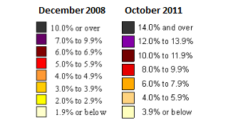

Notes:
Here’s the scale side by side. This makes the comparison of the two time periods impossible. In fact, looking at the maps and thinking that darker colors are worse, the maps seem to indicate that by 2011 things were much better, since most of the country is ligher.

Slide 11
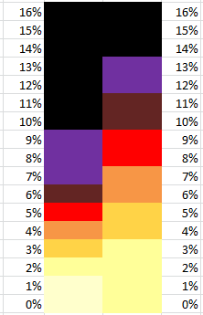
Notes:
In 2008 it was purple at 7%, but in 2011 it takes 12% to reach purple. In 2011, 5% is a low-value colored in yellow, but was red in 2008.

Slide 12
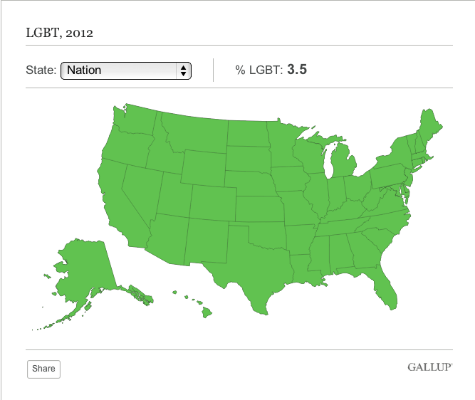
Notes:
This tool offers a Dropdown menu to choose the State, but when the entire nation is selected is simply colors everything at the average, which is not at all useful. Now we just have a green image of the U.S.

Slide 13
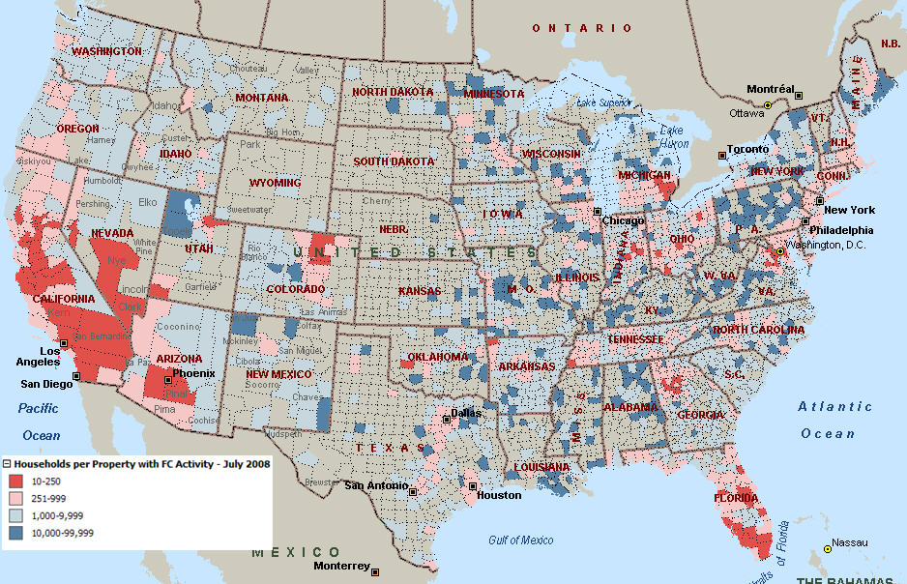

Foreclosures (July 2008)
Source: RealtyTrac (www.RealtyTrac.com)
Notes:
This map, done by RealtyTrack, is really well done. It shows the foreclosures by county in the United States during that same time period of 2008. It’s a colorblind friendly palette of blue and red and it’s easy to see which counties in the US were hit the hardest during this time. California, Nevada, Florida and Detroit were all hit really hard.

Slide 14
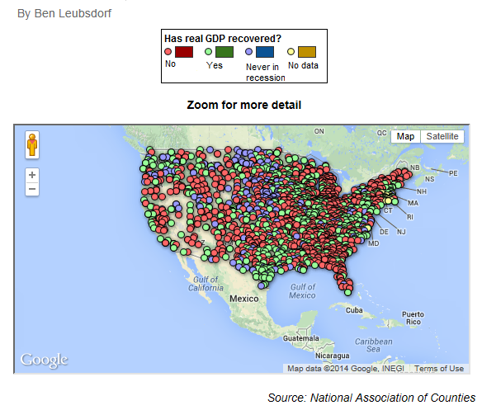
The Wall Street Journal – GDP Recovery by County
Notes:
Compare the county map from RealtyTrack to this map, which shows the GDP recovery by county using dots on the map. Dots can be useful, but in this case, plotting 3,000 dots that are fairly large and on top of each other really obscures the view of the counties. A shaded map, also called a choropleth map, would have been much better in this case, as well as avoiding red and green together as we discussed in module 4.

Slide 15

Notes:
[Animated GIF by darkhorseanalytics.com]

Slide 16
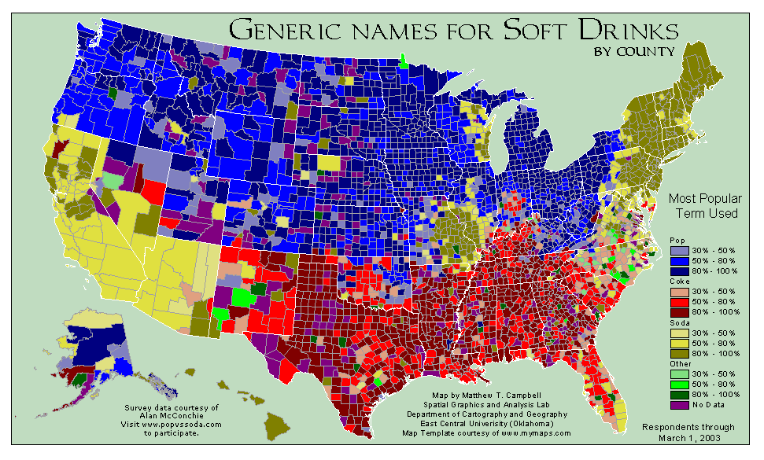
Created by Matthew Campbell and Prof. Greg Plumb of East Central University in Oklahoma
Source: http://www.huffingtonpost.com/2012/11/12/soda-vs-pop_n_2103764.html
Notes:
Here’s another example of data by county, this time showing what term people use as the generic name for Soft Drinks. This shows a Categorical-Sequential color scheme. It’s light to dark for prevalence of the term, but different color hues for the different names. If you grew up on the east or west cost then you probably used the term “Soda”. In the north and part of the Midwest, people use the term “Pop”. The south is the most interesting, because when you ask the waiter or waitress for a “Coke”, they will likely ask you what kind of “Coke”? To which you might reply “a Sprite”.

Slide 17
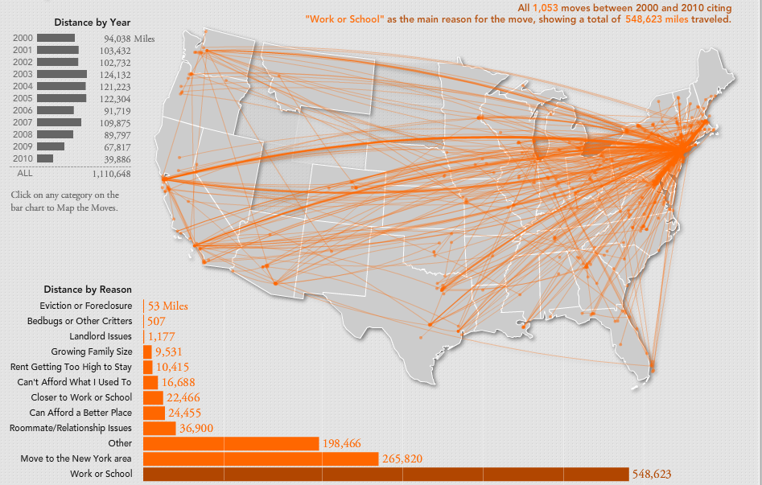
Created by Hermann Zschiegner
Source: http://www.two-n.com/wnyc/
Notes:
This map by Hermann Zschieger visualized paths of people moving and the reason why. This is an example where dots on a map, along with paths, works very well.

Slide 18
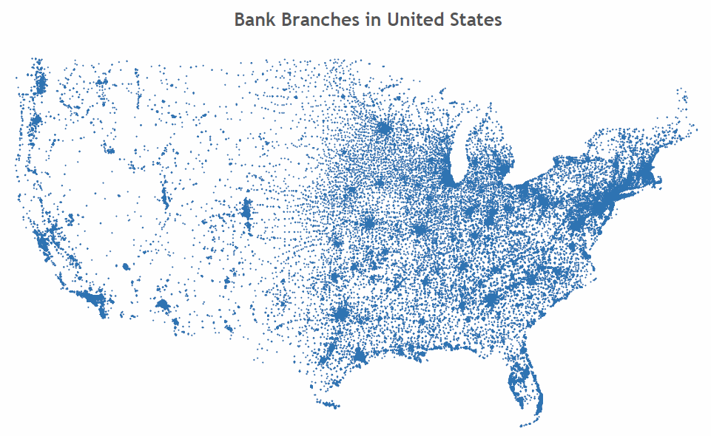
Created by Jeffrey A. Shaffer
Used by Permission
Notes:
This map of the Bank Branches in the United States was created by Jeff Shaffer. There is actually no map layer in this visualization, not even a country border. Yet we can still see the outline of the US clearly. This map is simply made up of 92,000 points on the map plotting actual location of each branch. It’s interesting to see where these bank branches are located, but it’s not very useful beyond that. In fact, if there were no title on this, I could have easily said this was the Verizon coverage map. It’s the same map that we would see if we plotted the post offices, or McDonalds locations. That’s because these places are going to be centered around the areas of the highest population. This is basically a proxy for a population map.
Let’s dive into the data and see what happens when we filter or add color.

Slide 19
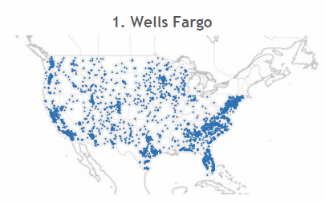
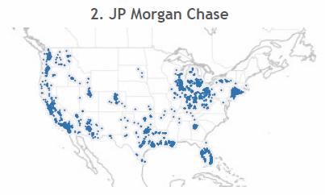
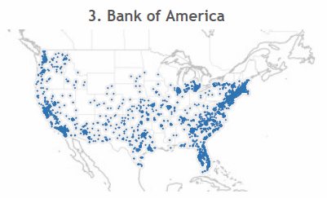
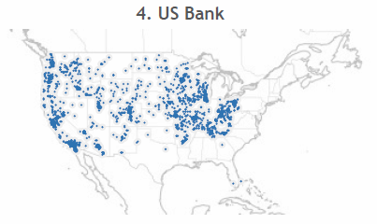
Created by Jeffrey A. Shaffer
Used by Permission
Notes:
Here is the distribution of the top 4 banks. Wells Fargo seems to have nationwide coverage, but as soon as we drop to #2 we can start to see some difference. US Bank does not have any branches on the east coast of the southern coast.

Slide 20
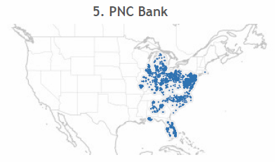
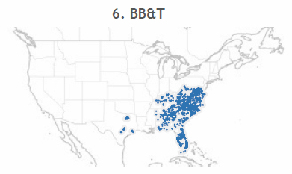
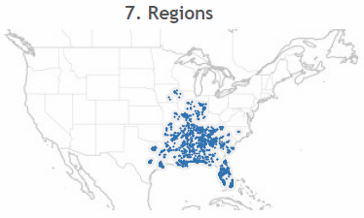
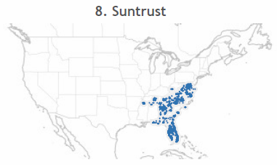
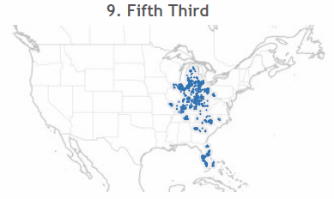
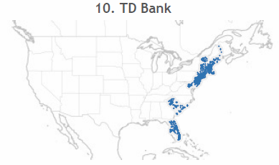
Created by Jeffrey A. Shaffer
Used by Permission
Notes:
When we drop to #5-10 we can really see the differences in the data. We’re still in the top 10 banks in the US and they are all very different. Regions Bank is very heavy in the south while TD Bank is on the east coast. Fifth Third is heavy in the Midwest bear their headquarters in Cincinnati, Ohio.

Slide 21
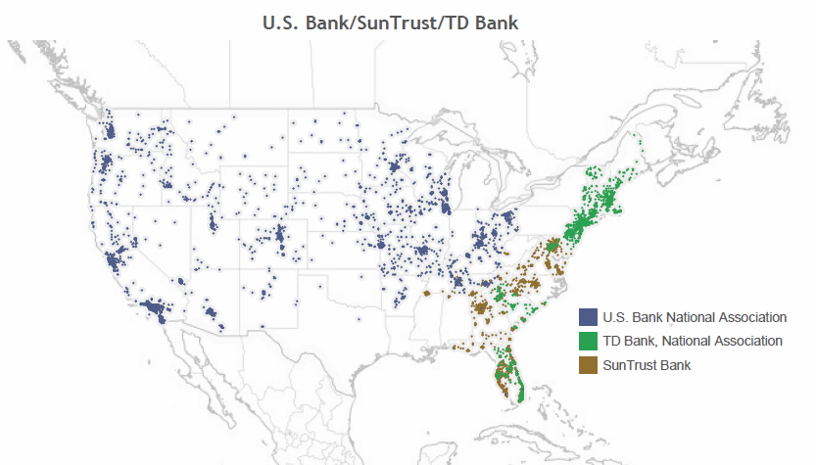
Created by Jeffrey A. Shaffer
Used by Permission
Notes:
Adding some color and filtering a few banks together we can see some interesting patterns. For example, if US Bank were looking to expand their bank branch coverage in the US, TD Bank and SunTrust would be very complimentary banks to help them fill in the east coast and the south.

Slide 22
Beautiful Trash
a week of trash routes in Cincinnati
Notes:
This is another visualization by Jeff, showing trash routes in Cincinnati, Ohio using public data from Open Data Cincinnati.

Slide 23
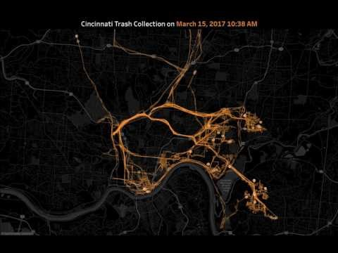
Notes:
He created this video to show the trash routes for his trash day, mapping all of the truck movements for Tuesday, March 15th, 2017. The trucks start at 6am on the west side of Cincinnati. They work through the neighborhoods, street by street. Starting around 9am and through the morning, the trucks start heading north to the landfill to empty their trucks. By 1pm the trucks have filled in most of the day’s route through the neighborhoods, but a few of them continue until 4pm.

Slide 24

Notes:
He then mapped the entire week, which is interactive. Clicking the day of the week will filter the route for that particular day.

Slide 25
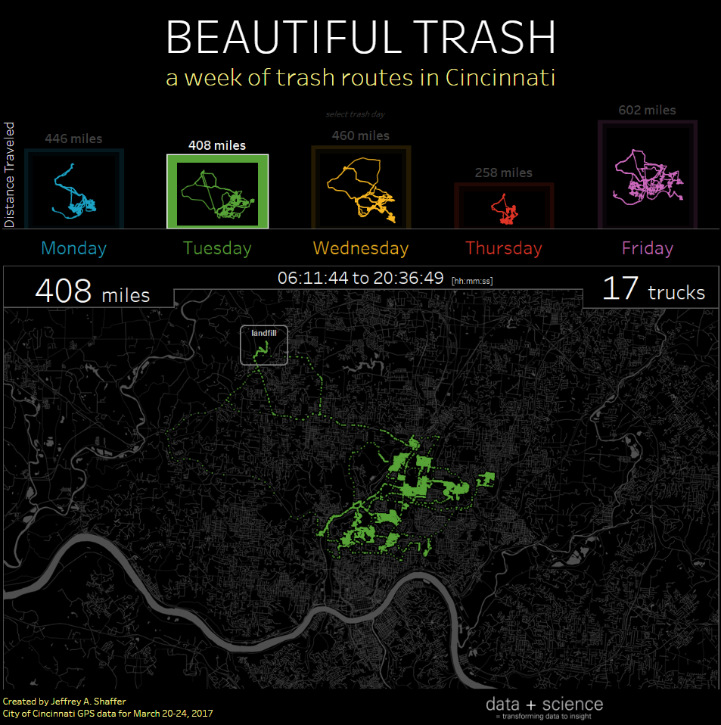
Notes:
Here’s Tuesday.

Slide 26
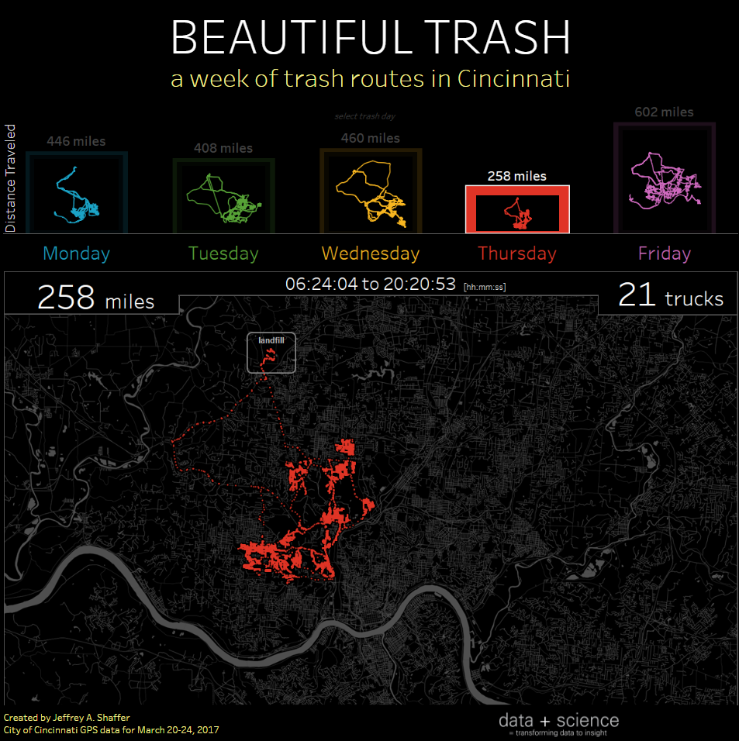
Notes:
And Thursday.

Slide 27

Notes:
And Friday.

Slide 28
Geocoding

Slide 29
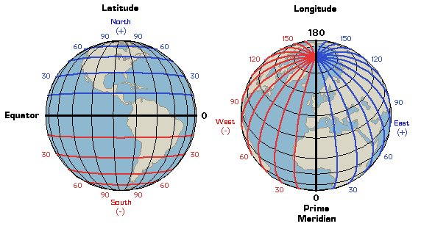
Longitude and Latitude
Credit: Illinois State University
Source: http://www.learner.org/jnorth/tm/LongitudeIntro.html
Notes:
The process of geocoding is taking an address, for example 123 Main Street and converting it to a Latitude and Longitude. Latitude lines are horizontal lines across the earth. Longitude lines are vertical lines.
Above the equator in the northern hemisphere, the Latitude lines are notated as North or positive numbers, below the equator they are notated as South or negative numbers.
To the east of the Prime Meridian, Longitude lines are notated as East or positive numbers and to the west of the Prime Meridian they are notated as west or negative numbers.

Slide 30
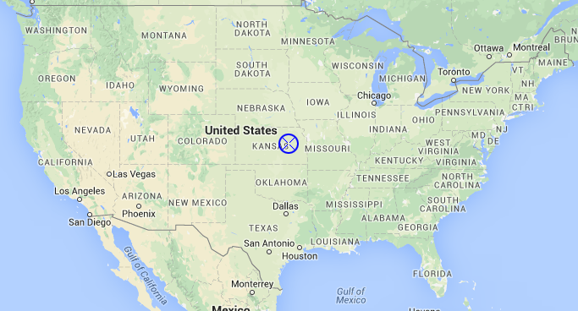
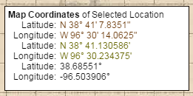
Longitude and Latitude
Source: http://www.findlatitudeandlongitude.com/
Example Notation:
N 38° 41’ 7.8351” degrees, minutes, seconds decimal
N 38° 41.130586’ degrees, minutes decimal
38.68551° degrees decimal (use this # without ° for Tableau)
Notes:
Latitude and Longitude are typically expressed in one of two ways. For example, the Latitude shown here is North 38 degrees, 41 minutes and 7.8351 seconds (which is showing the seconds decimal)
Most business intelligence tools and mapping software geocode using degrees decimal. The math conversion between the two is very simple. Just divide the minutes and second by 60.
7.8351 seconds divided by 60 = .130586
41.130586 divided by 60 = .68551

Slide 31
Batch Geocoding
http://www.gpsvisualizer.com/geocoder/
https://www.geocod.io/
2,500 free per day ($0.50 per 1,000)
https://geocoding.geo.census.gov
1,000 free per day
Notes:
There are many different ways to geocode and address. There are packages in R and Python, but there are also number of tools available online. If processing really large files of address then you or your company would likely be using a commercial grade solution. Many companies automatically geocode all of their addresses in their system.

Slide 32
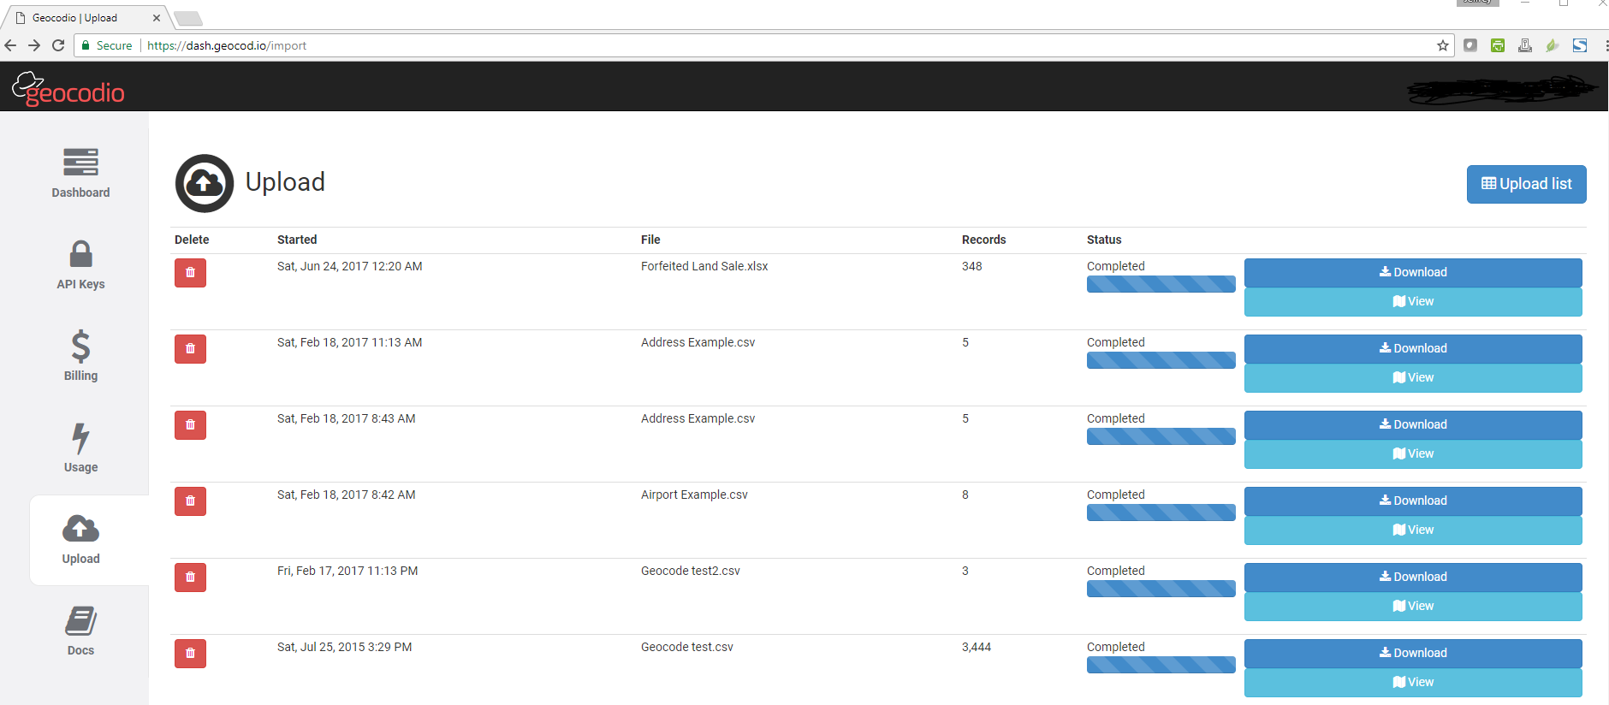
https://www.geocod.io/
Notes:
Geocod.io has a very nice interface and allows for 2,500 records per day for free and it’s fairly cheap to process after that. You can upload files to their website and then download the results. In addition to geocoding, Geocod.io also appends additional fields to the output that you might find useful.

Slide 33
Calculate Distance between two lat/long points
(the problem - the world is not flat)
=ACOS(COS(RADIANS(90-Lat1)) *COS(RADIANS(90-Lat2)) +SIN(RADIANS(90-Lat1)) *SIN(RADIANS(90-Lat2)) *COS(RADIANS(Long1-Long2))) *6371
To calculate distances in miles, substitute R (6371) with 3958.756 (and for nautical miles, use 3440.065)
source: http://bluemm.blogspot.com/2007/01/excel-formula-to-calculate-distance.html
Notes:
You might find the need to calculate the distance between two points on a map. This requires a bit of math, because the world is not flat. This formula can be used in any program that offers these functions (cosine, sin, radians, etc.) This will work well in programs like Excel or Tableau. You simply input the Latitude and Longitude for the two points and the distance, as the crow flys, will be calculated in kilometers, miles or even nautical miles.

Slide 34
Basic Geo-Coding for Tableau

Slide 35
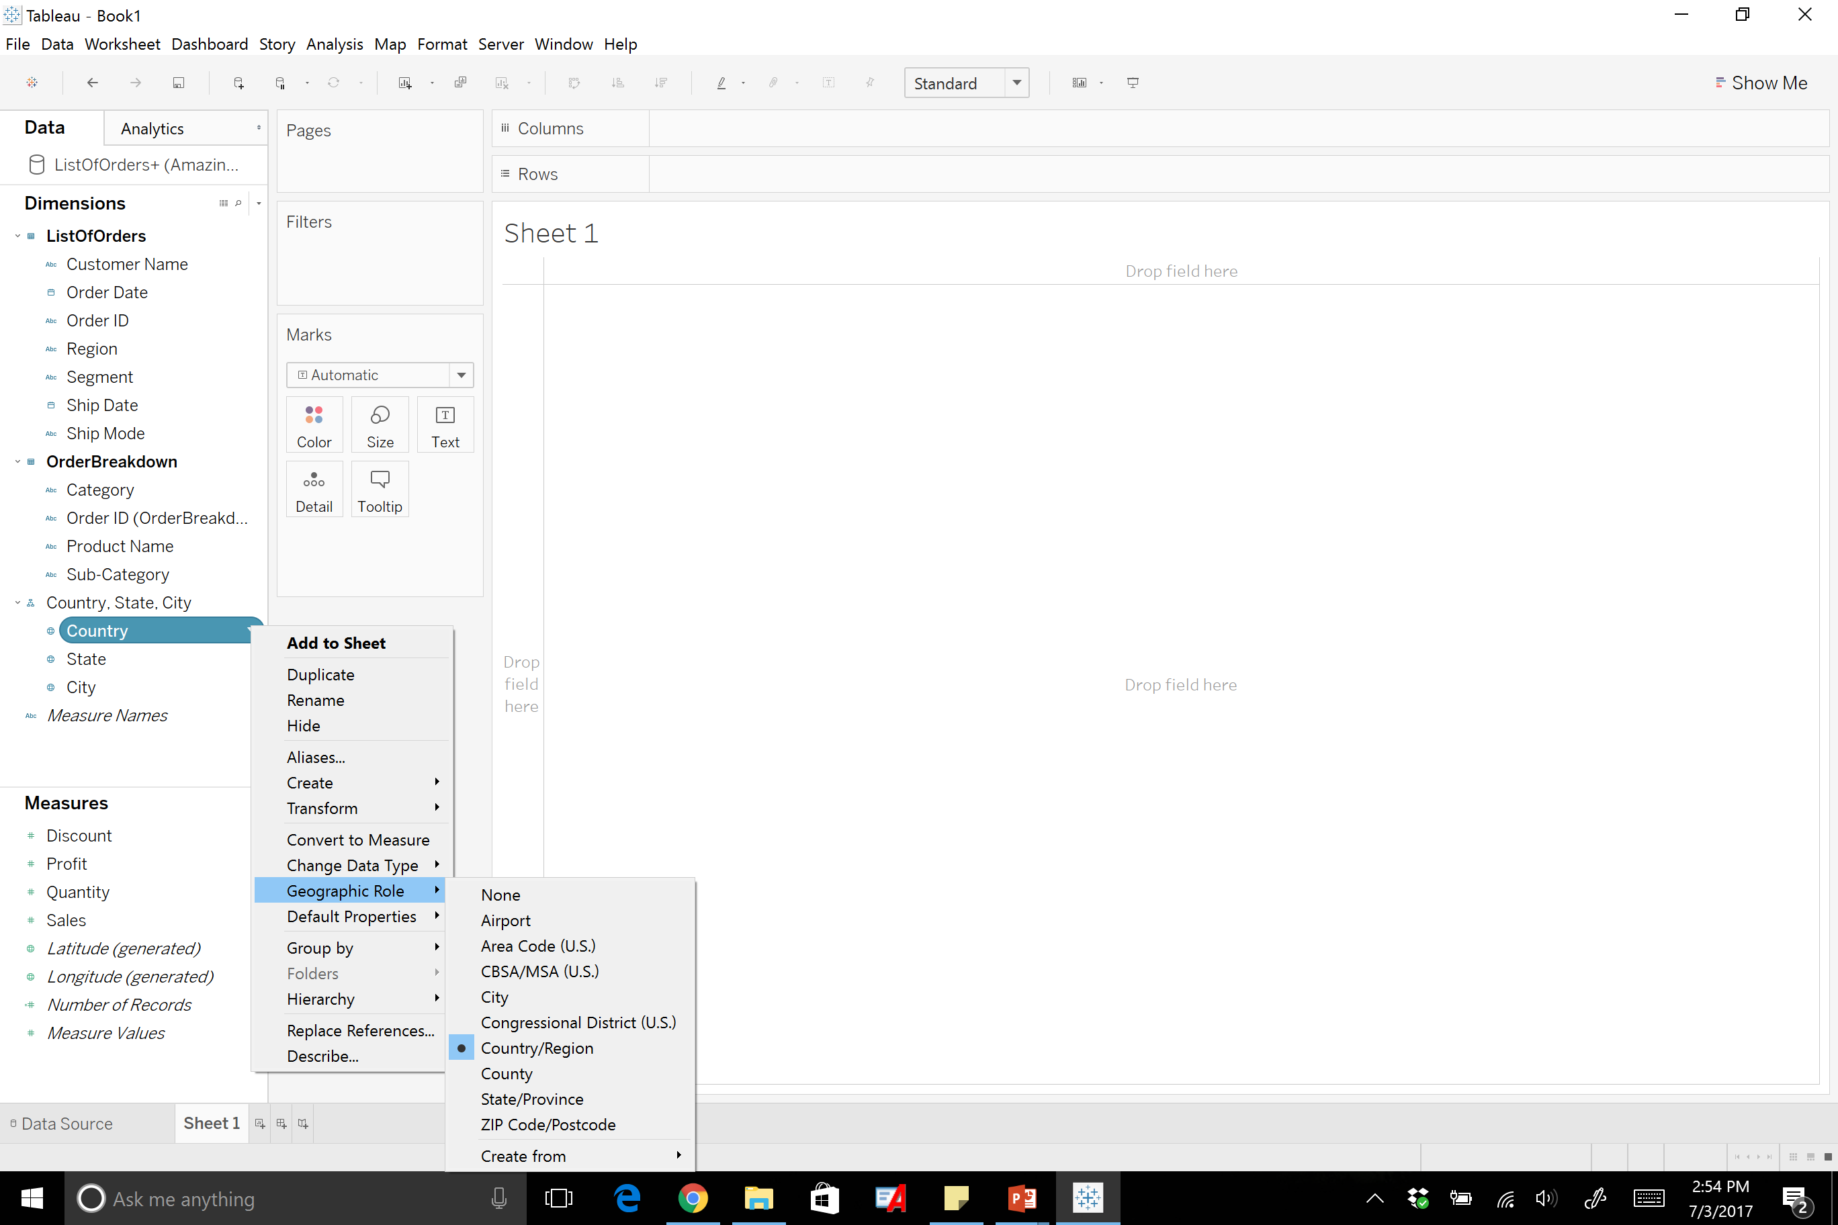
Notes:
Any data set that includes country, state, city, or longitude and latitude can be used as spatial data. If the dimension is not identified by tableau as geographic data, it can be changed to reflect spatial data.

Slide 36
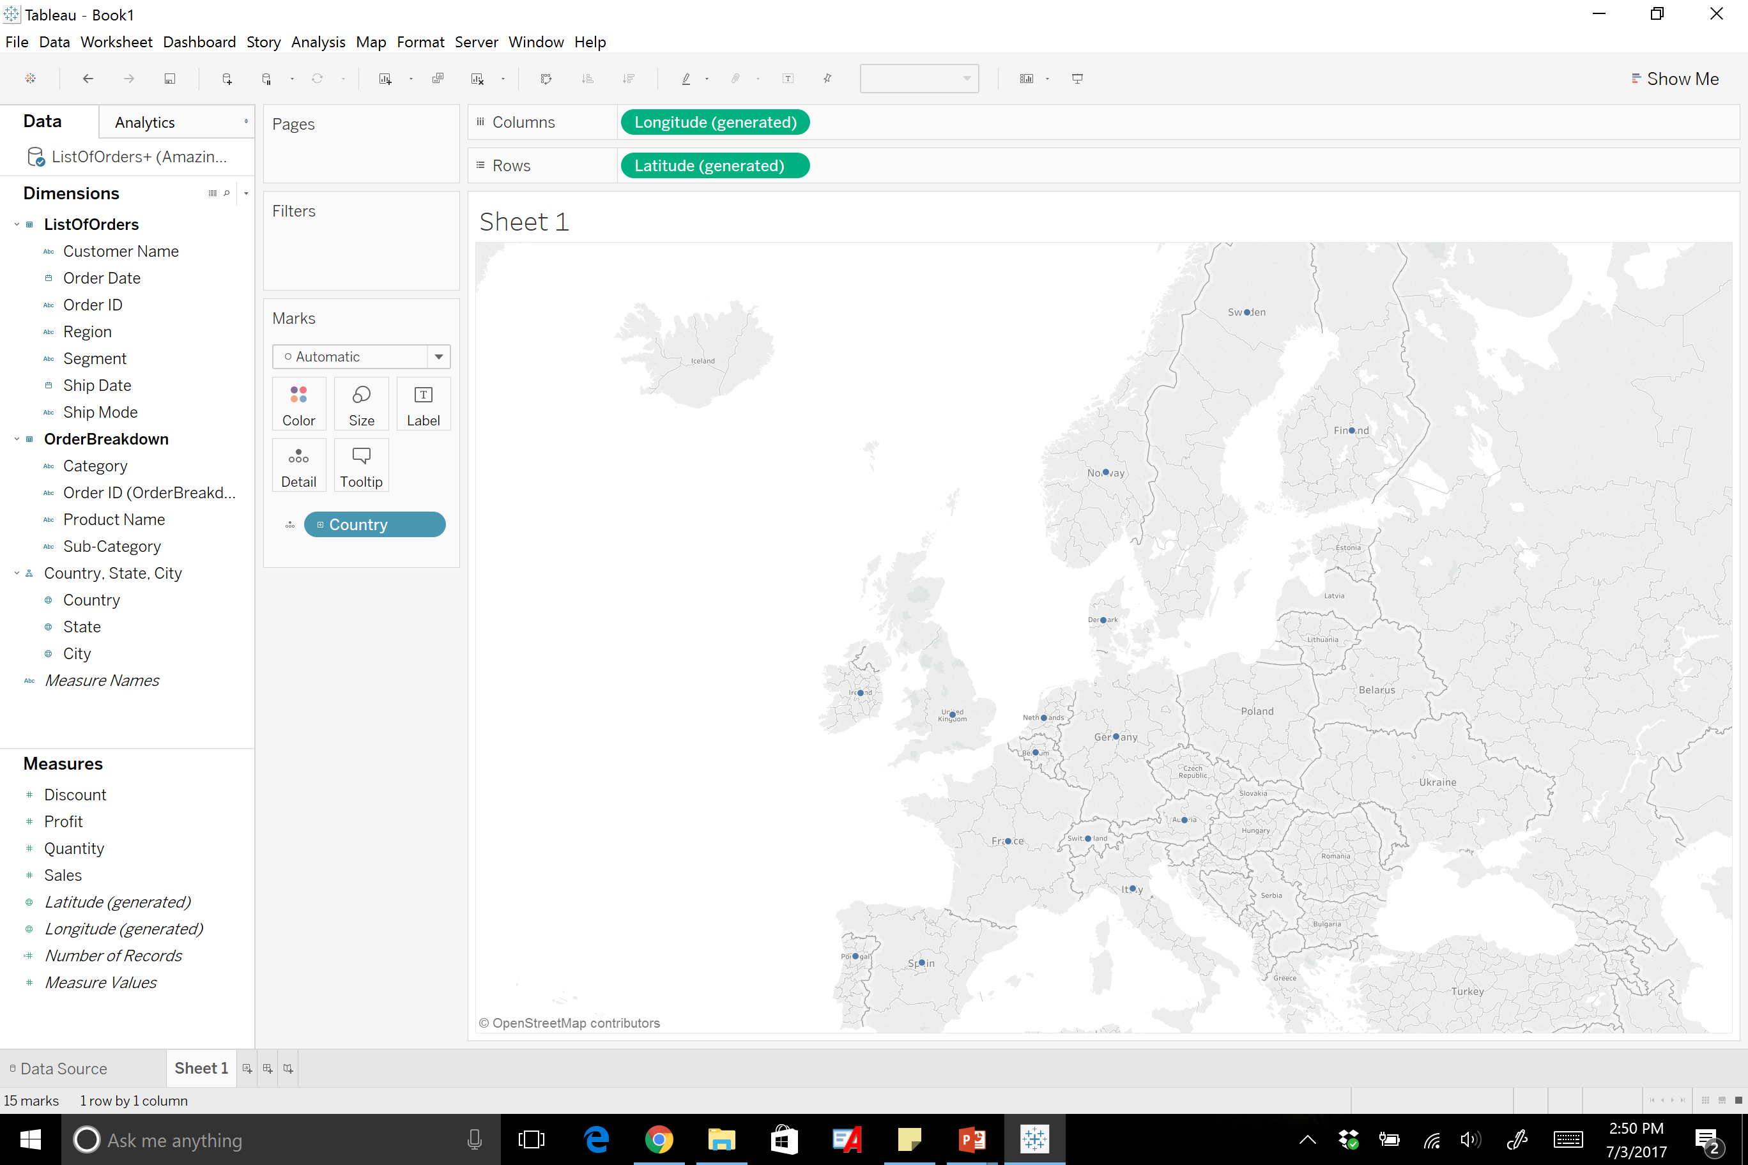
Notes:
To get the generated longitude and latitude drag the dimension you want to see either into the sheet, or under detail in the marks card. As you can see here each country has a dot representing the different countries.

Slide 37
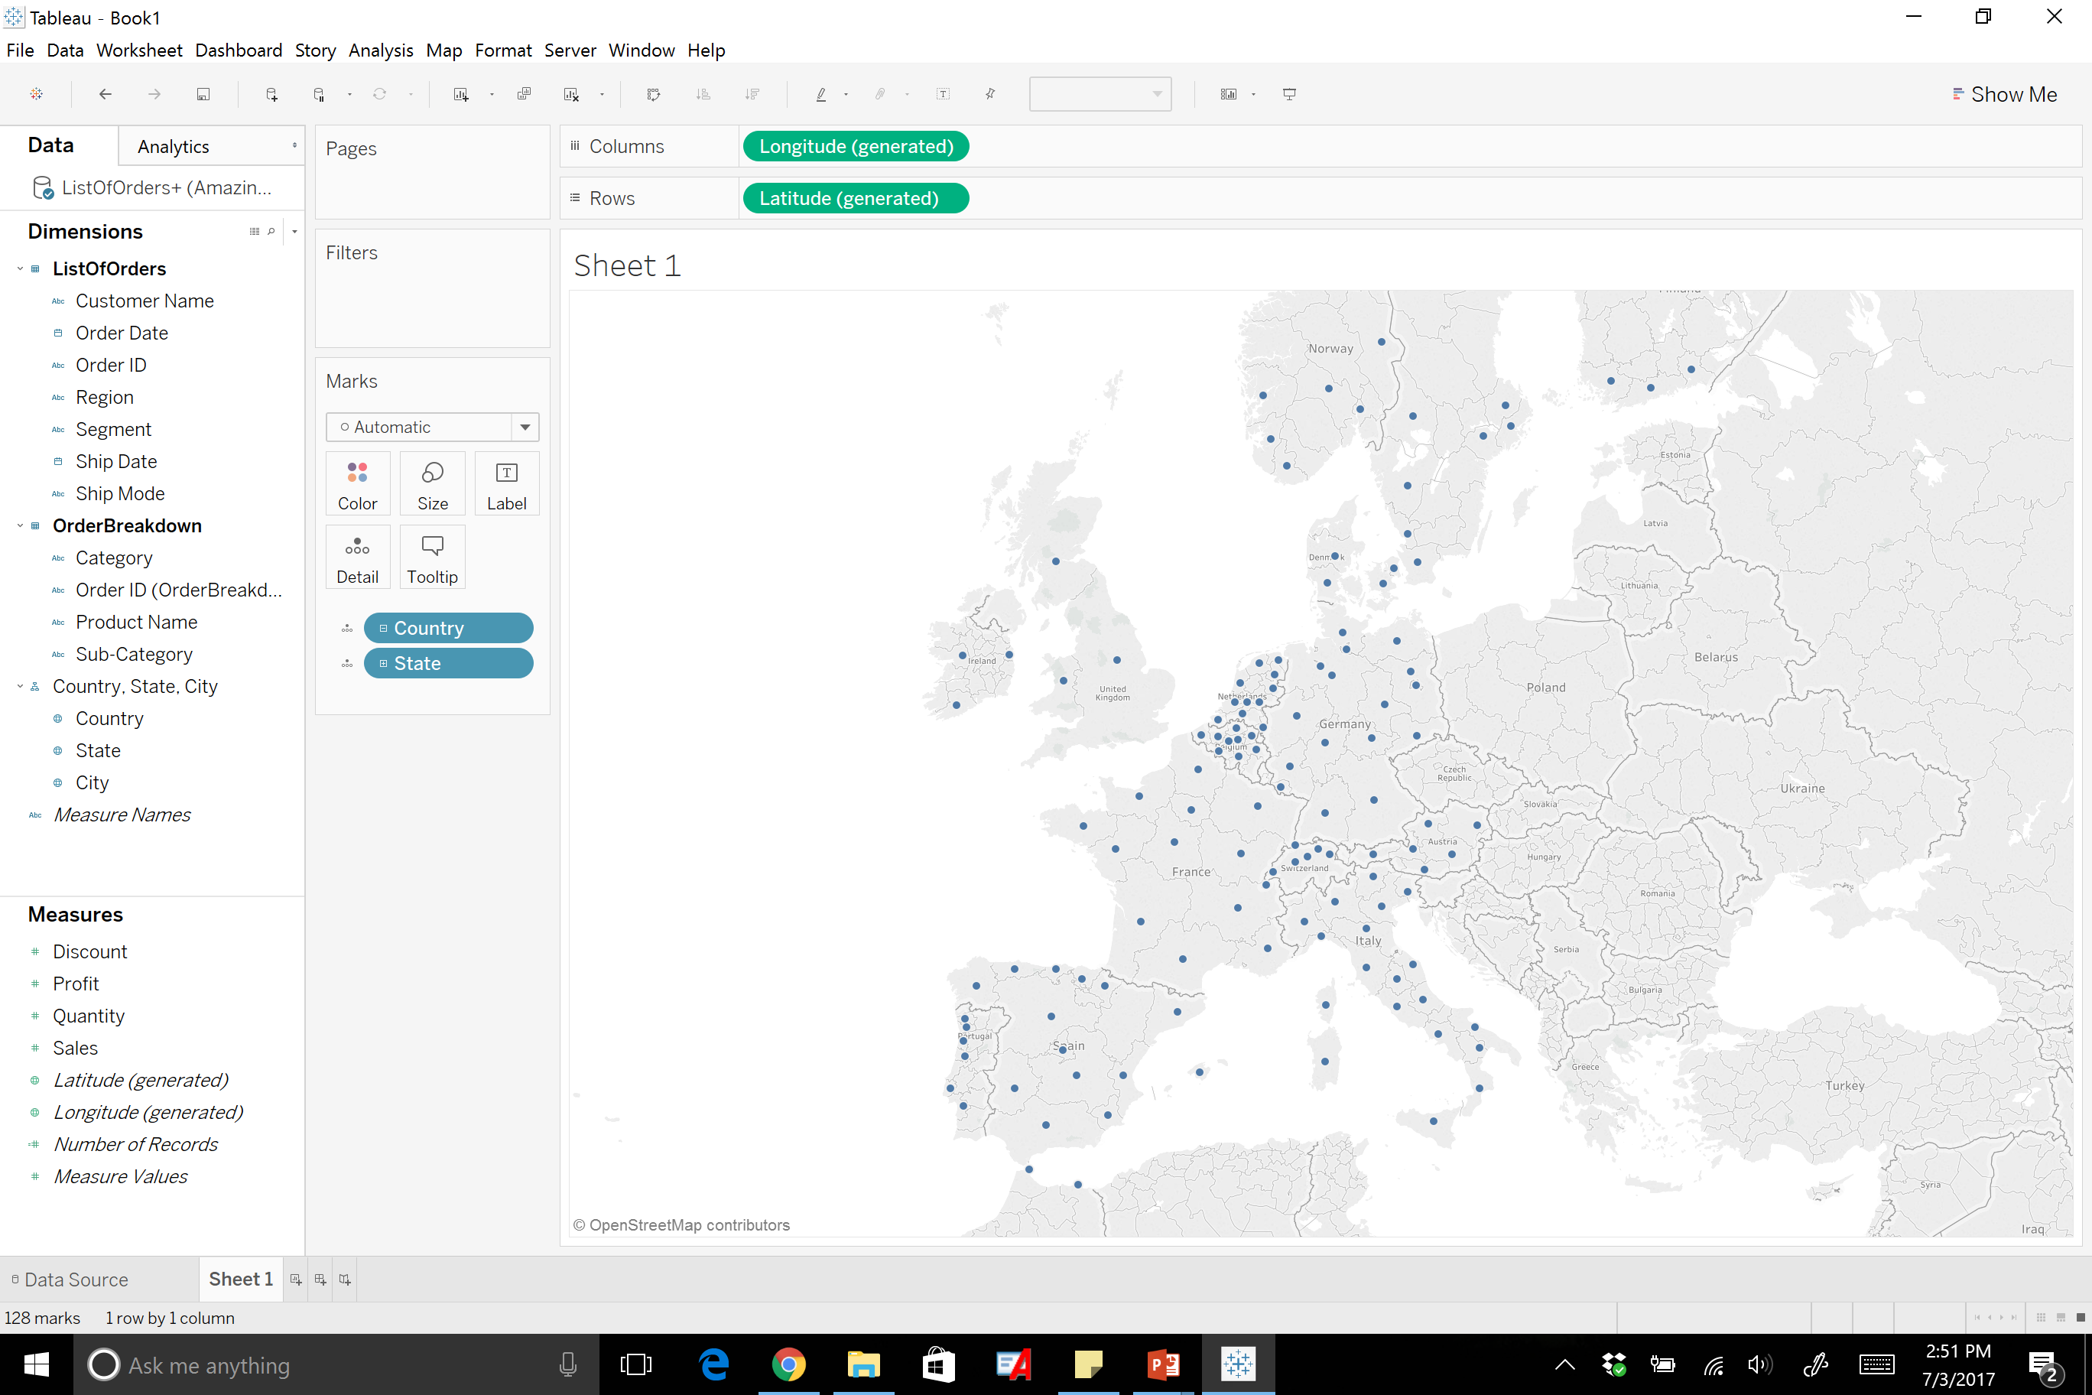
Notes:
This can be changed to states…

Slide 38
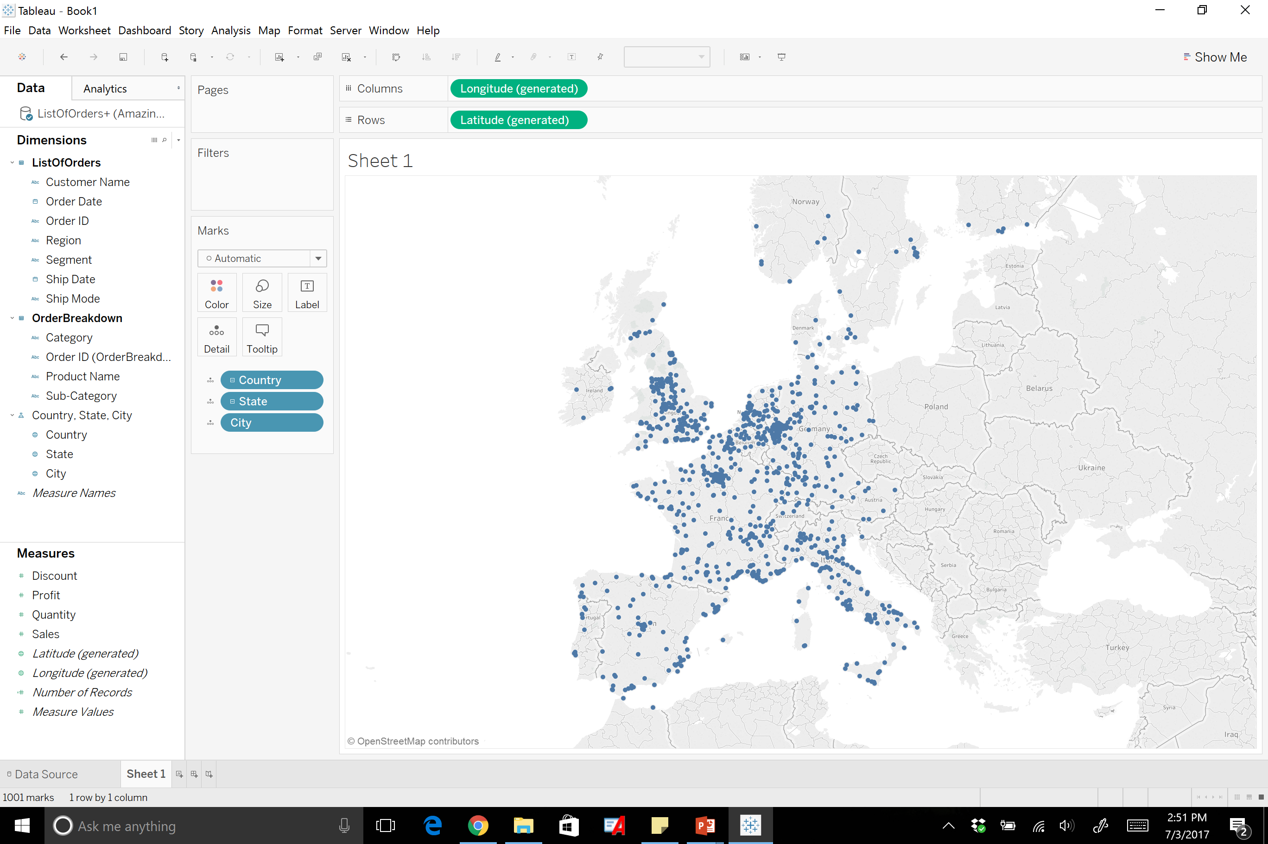
Notes:
….. And cities.

Slide 39
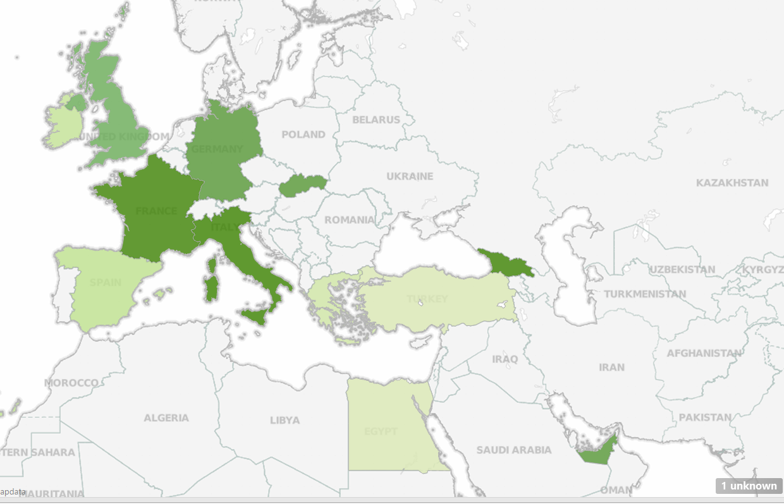
Notes:
From here a map can be created based on the data provided to provide meaningful analysis.

Slide 40
Adding Mapbox for Additional Designs

Slide 41
What is Mapbox?
Mapbox is a mapping platform used by developers to integrate location into any mobile or online application. Mapbox is paired with Tableau to help increase the designs that can be created in tableau.
To move forward create a free mapbox account here to get the API access tokens needed:
https://www.mapbox.com/

Slide 42
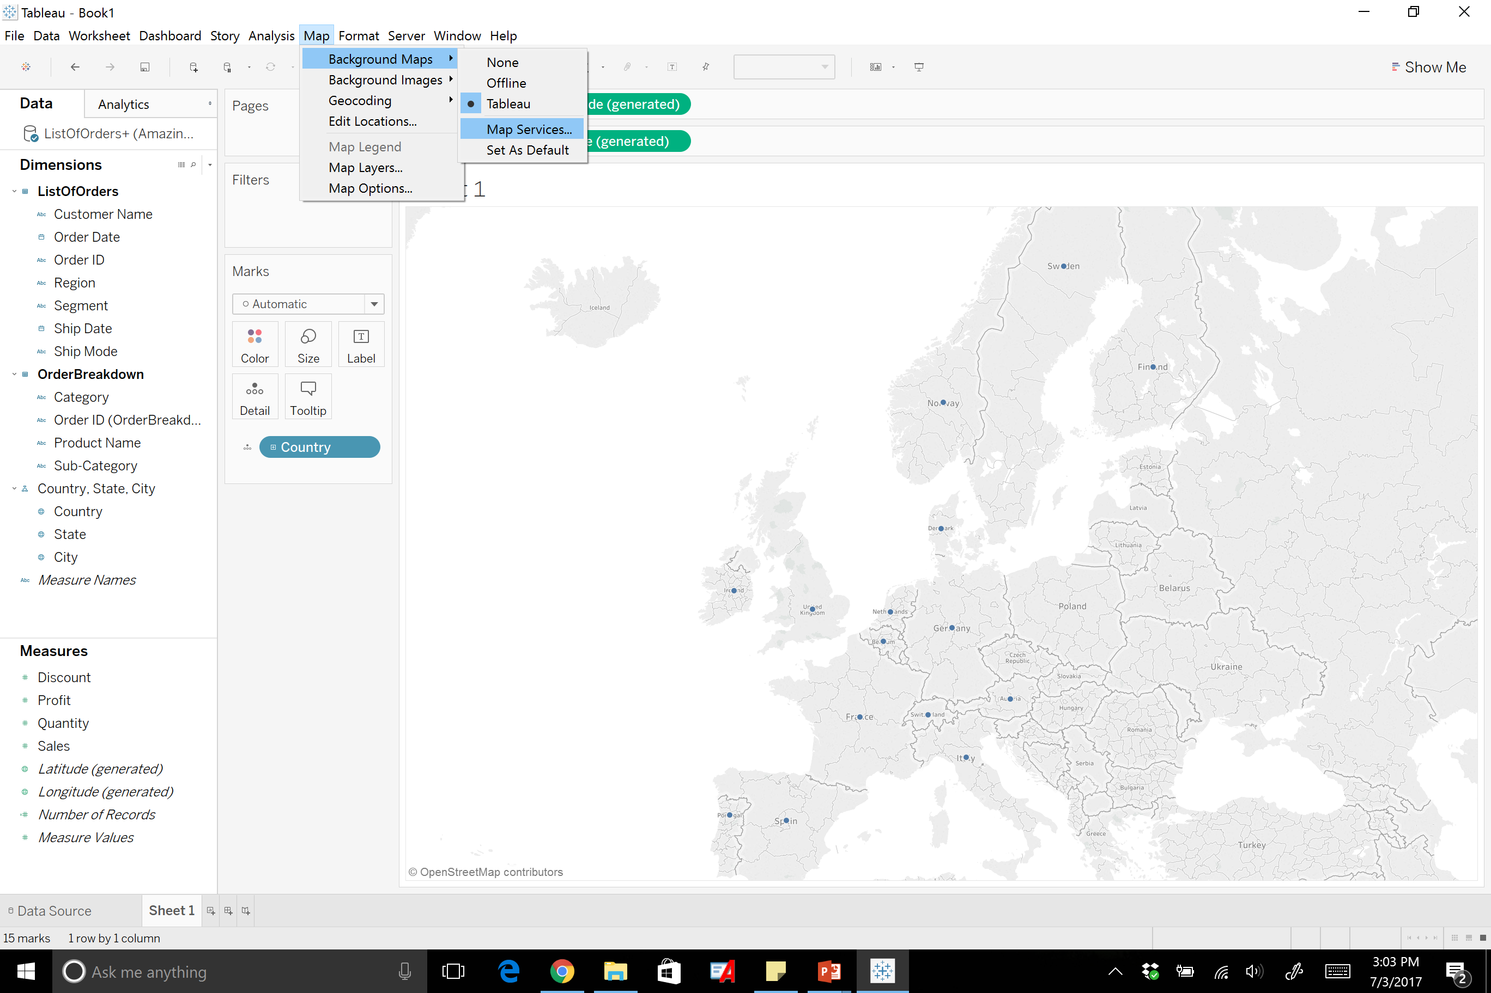

Slide 43
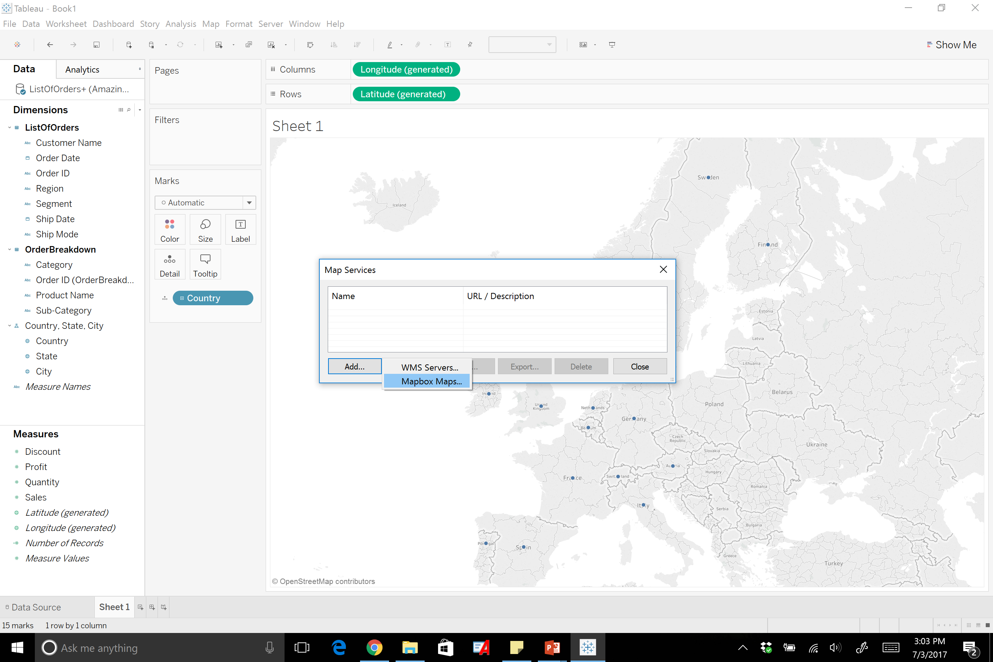
Notes:
Once you are in map services click add – mapbox maps

Slide 44
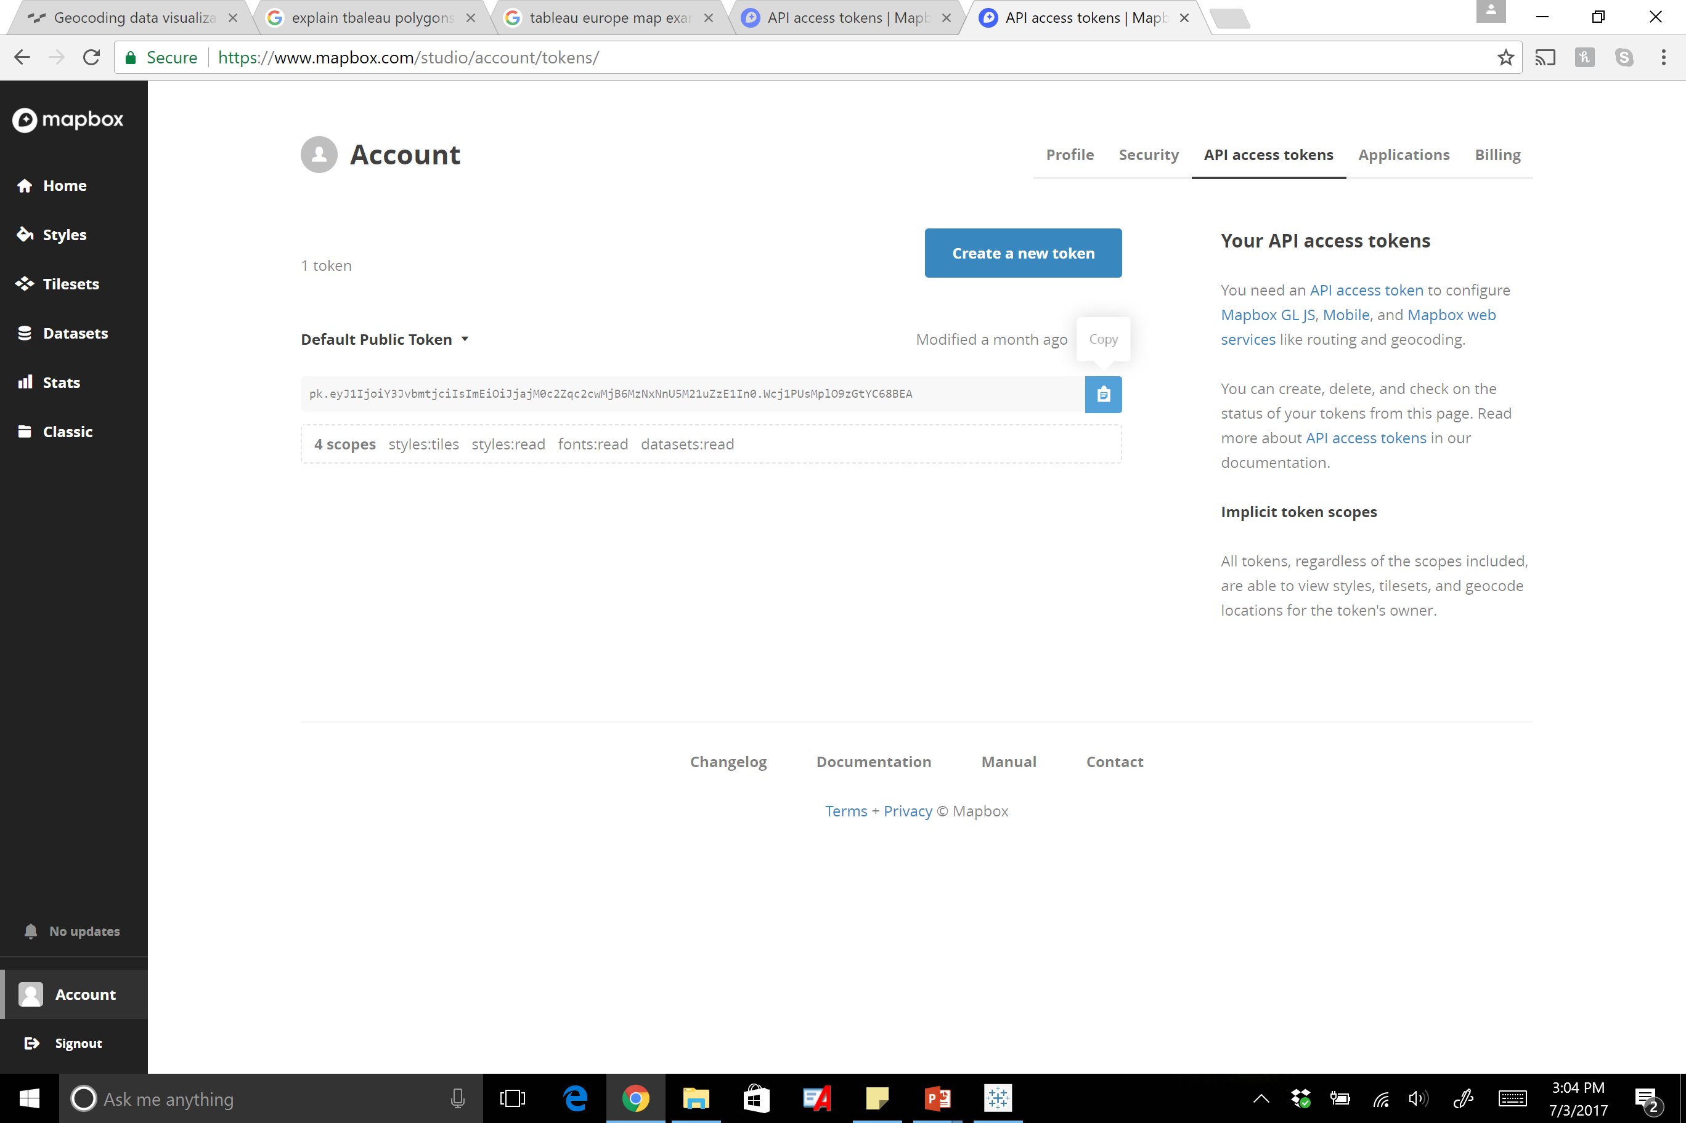
Notes:
After you are in to the mapbox maps in tableau, log into your mapbox account online to access the online token. Copy this onto your clipboard.

Slide 45
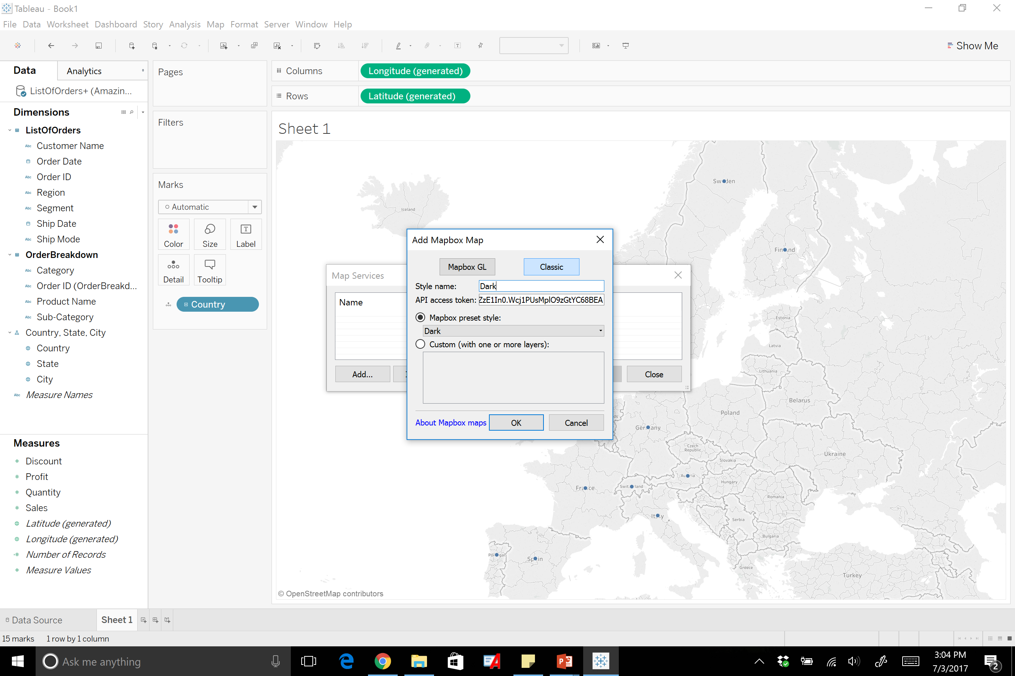
Notes:
You then will click classic – name the style – and paste the token. You can then use the map box preset style to pick a style you like.

Slide 46
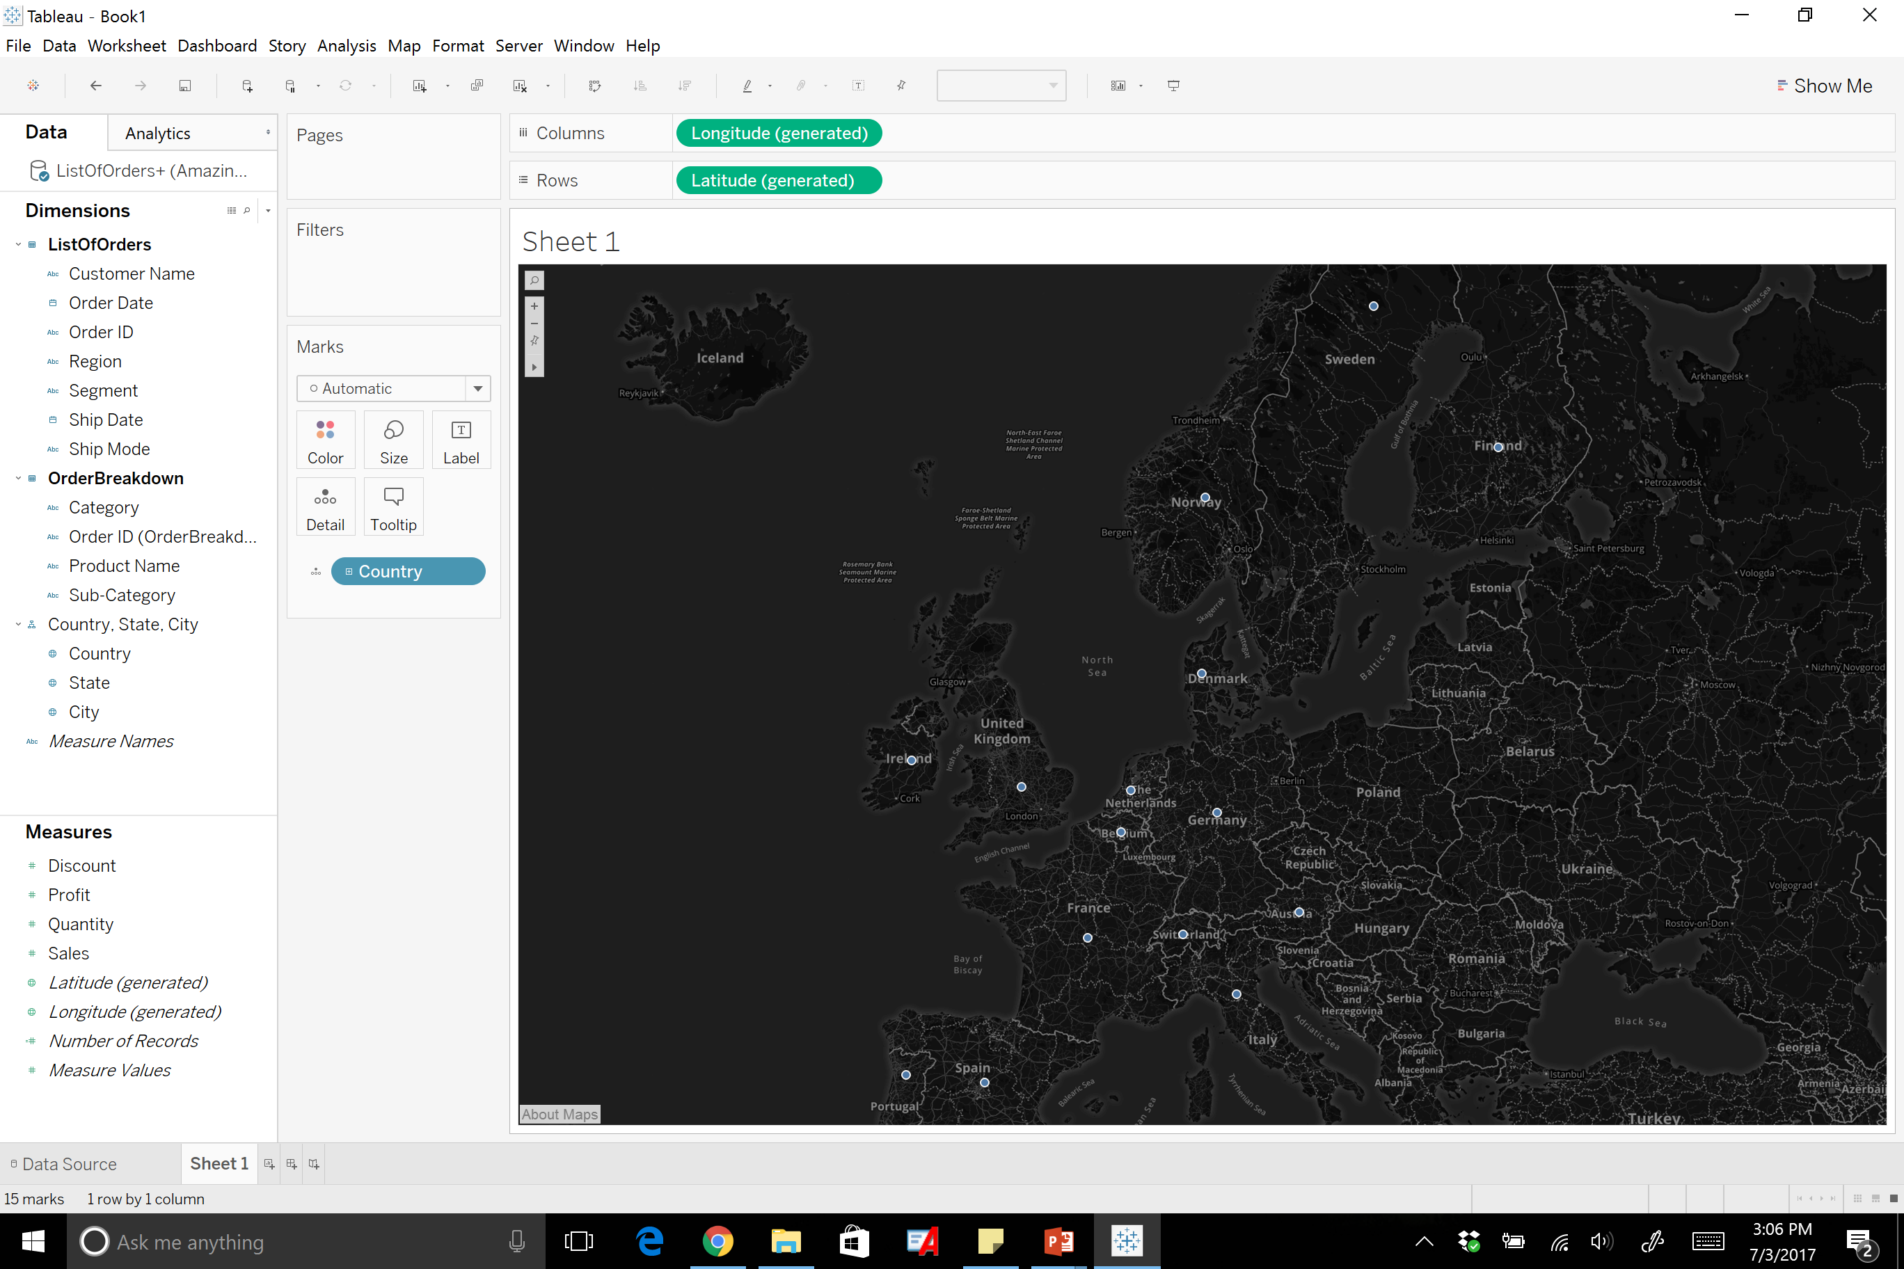
Notes:
Once you click Okay the new map background will be displayed.

Slide 47
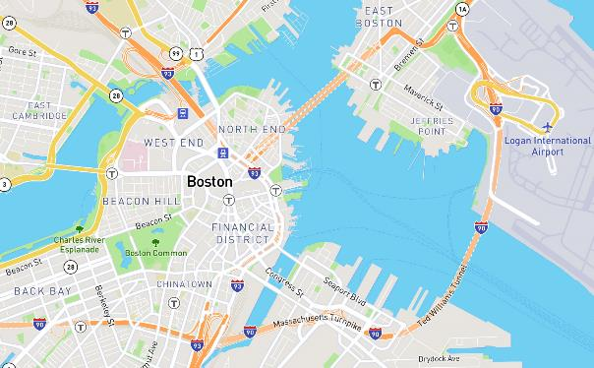

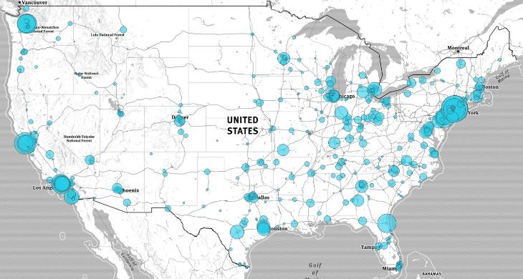
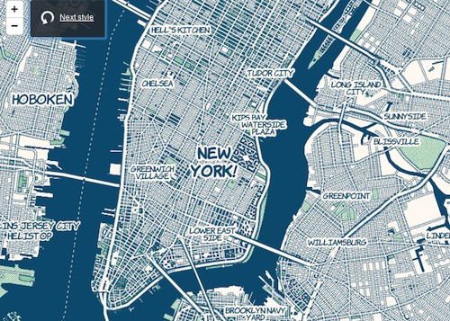
Notes:
Examples of background maps you can use through mapbox.

Slide 48
Dual Axis Mapping
Notes:
Source: https://www.interworks.com/blog/dyu/2017/03/09/data-viz-mapping-dc-potholepalooza-2016

Slide 49
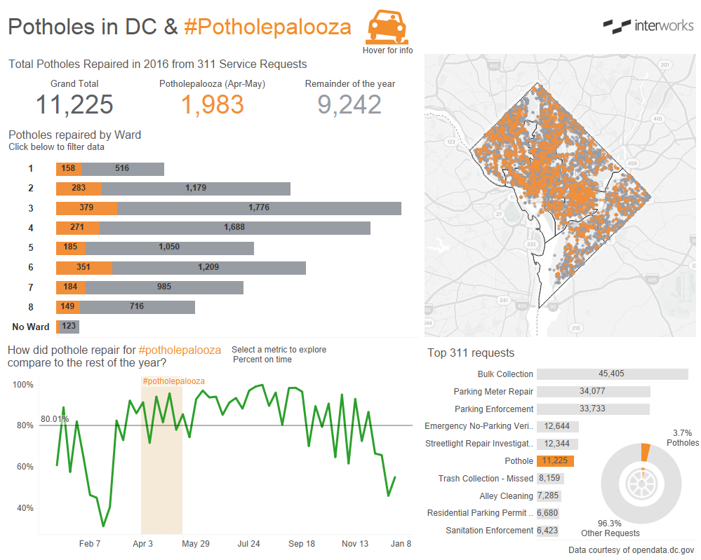
Source: https://www.interworks.com/blog/dyu/2017/03/09/data-viz-mapping-dc-potholepalooza-2016
Notes:
The map in the top right hand corner is a dual axis map. It contains polygons mapping out the different neighborhoods and contains the location of potholes that were fixed in the city of Washington DC.

Slide 50
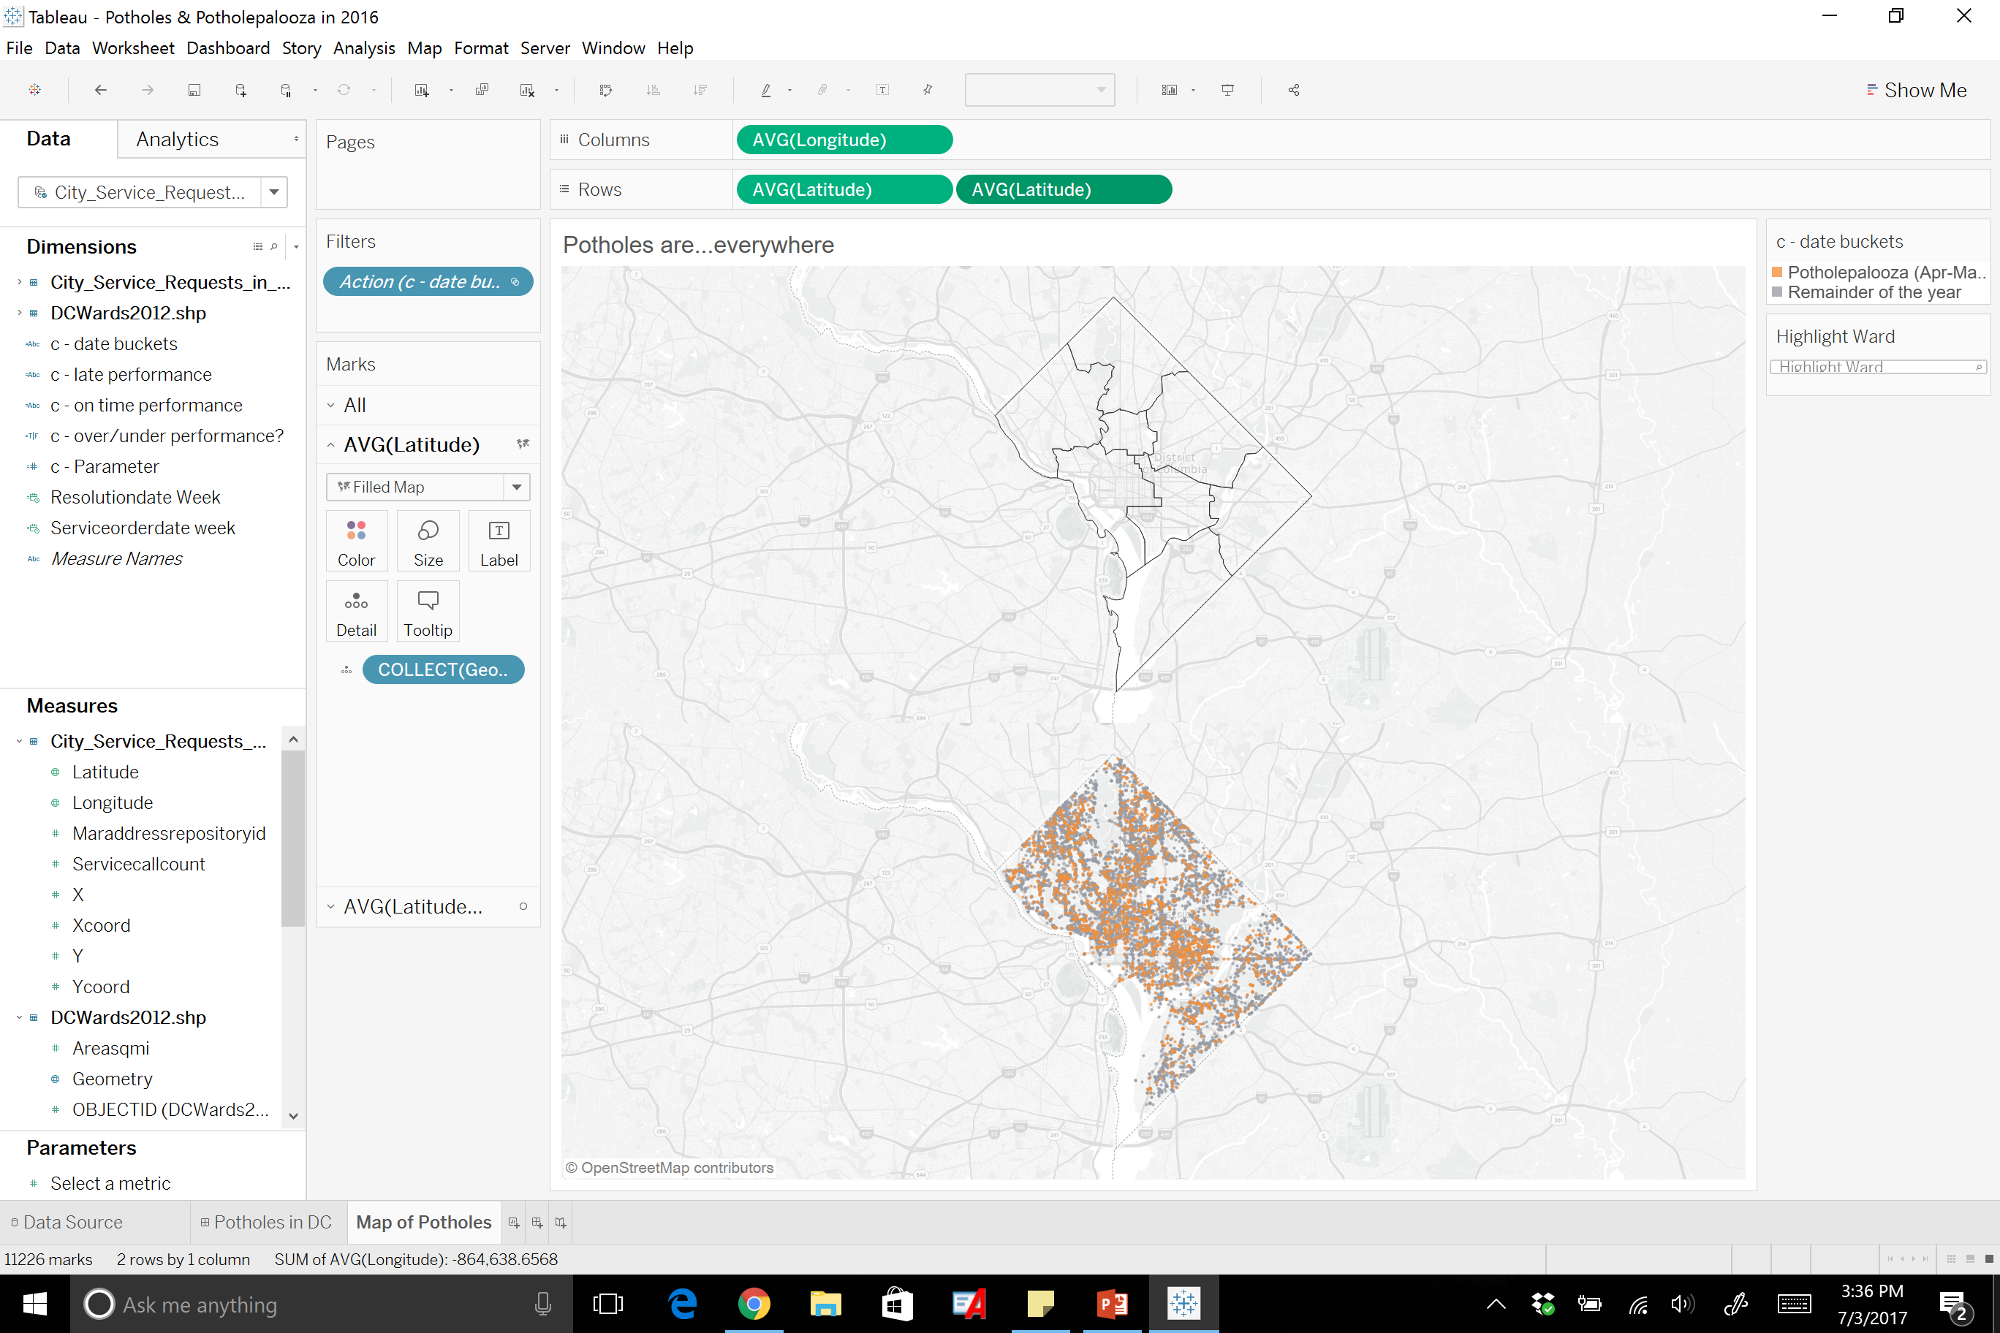
Notes:
To achieve this you first drag the geometry measure to the details to create the map as shown in the first section. Then you drag the a second latitude to the rows section to make two maps. From there on the marks card, you will see two latitudes. The one highlighted now is the top one and it is the polygons for the neighborhoods.

Slide 51
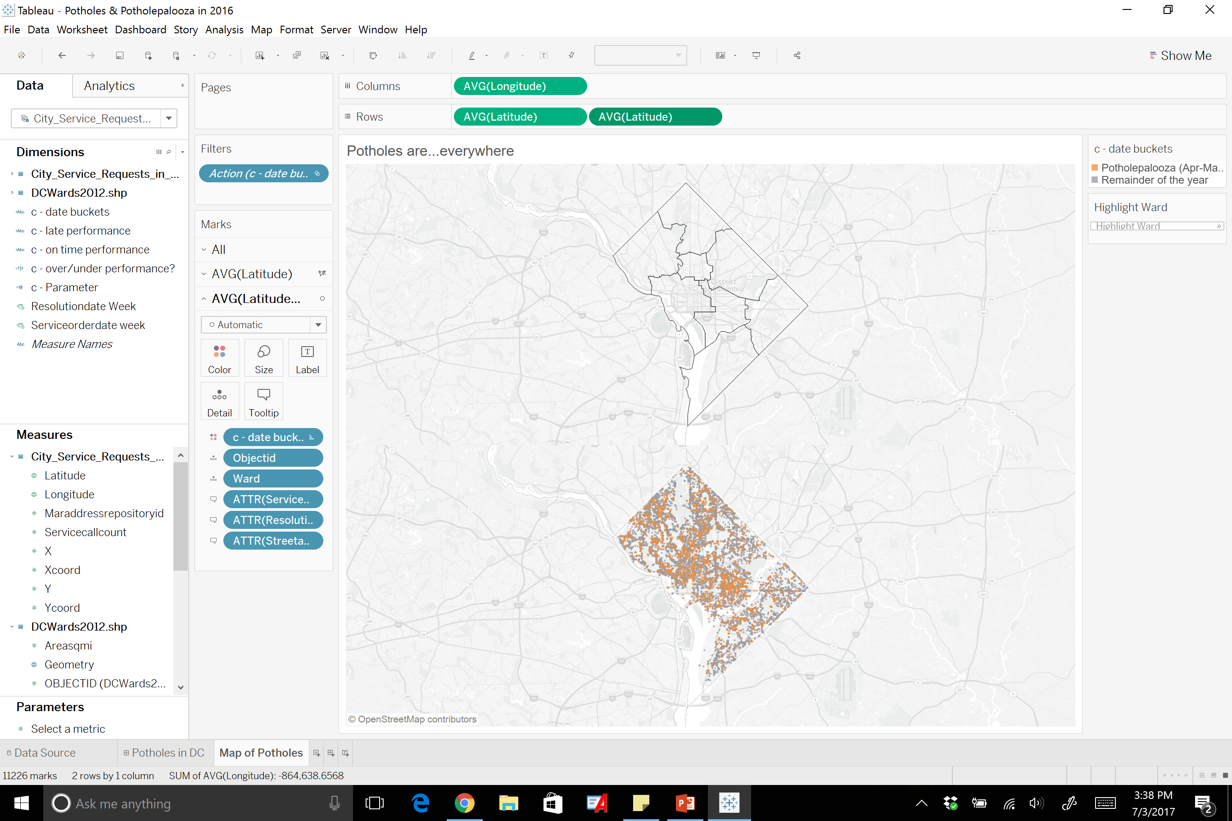
Notes:
The second one is the map below, and it shows the points in the analysis.

Slide 52
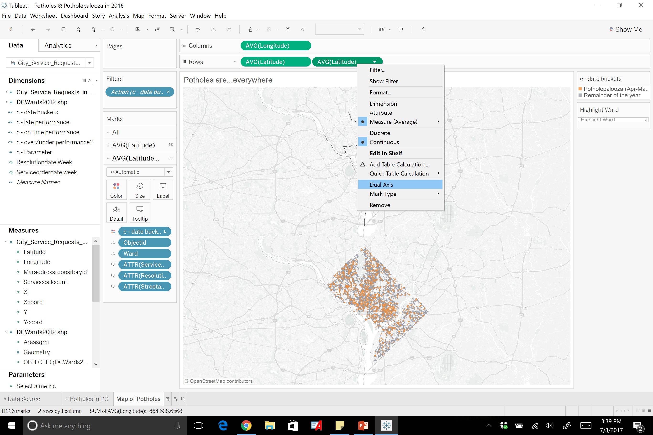
Notes:
To combine them you highlight the second latitude and click “Dual Axis”

Slide 53
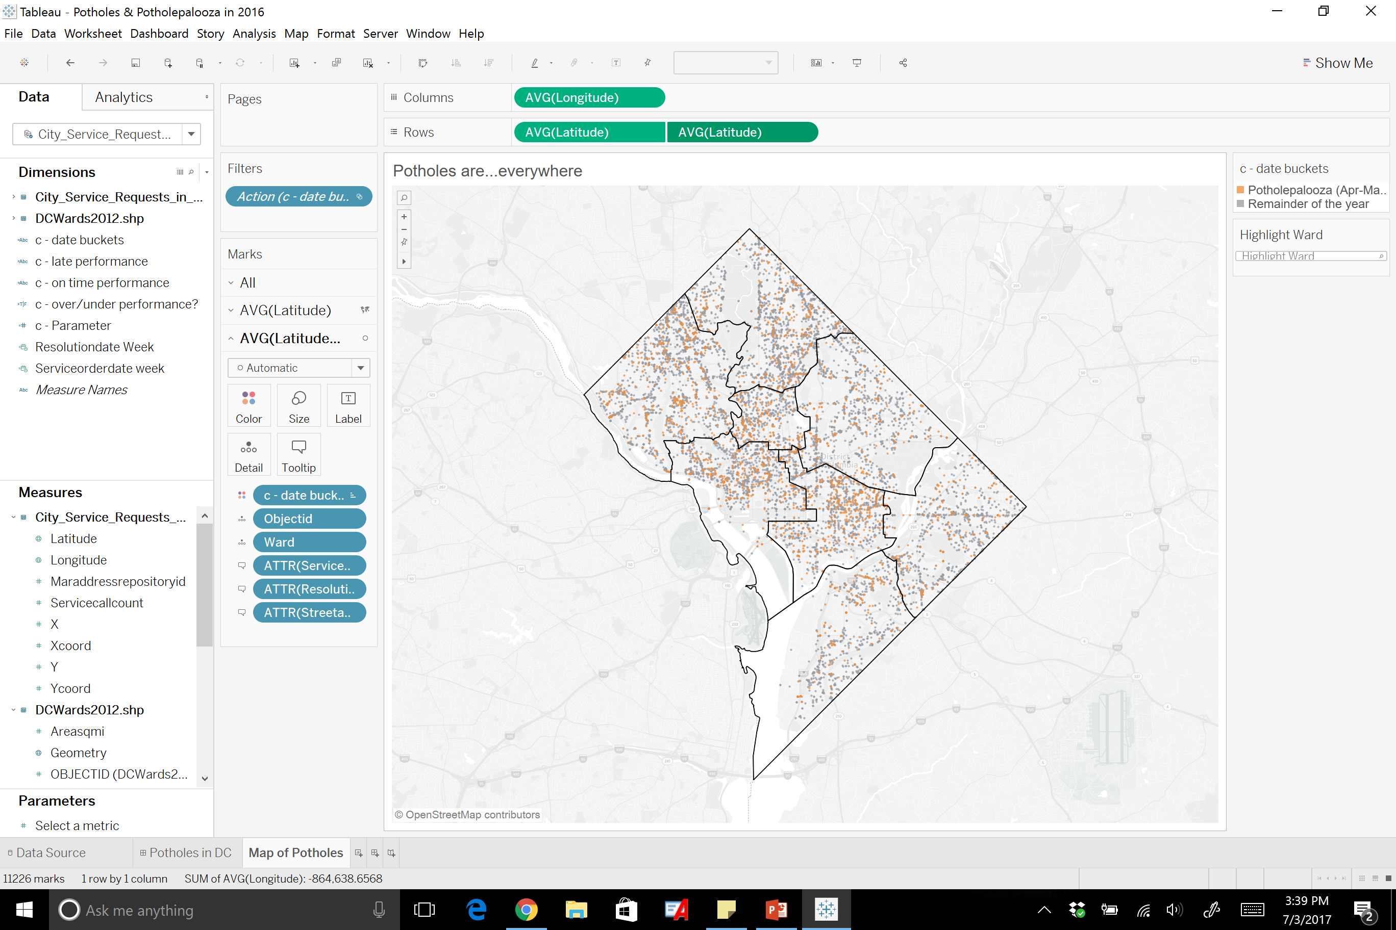

Slide 54
Amendment to the Rehabilitation Act
Section 508 - required for Federal Agencies, encouraged use for all companies.
http://www.joefreelance.com/508background.html
GIS not currently compliant
Notes:
This slide should be moved to Mapping deck.

